Slide 1

Project 3 Presentation
Data Visualization
My name

Slide 2
Travel Patterns Dashboard Presentation
Objective:
To analyze travel behaviors and preferences using a dataset of travel details. The dashboard visualizes various metrics such as destinations, transportation types, and accommodation preferences, allowing for insights into travel trends and patterns.

Slide 3
Project Summary
Phase | Key Activities | Tools and Languages
Project Planning and Proposal | Define objectives, Identify key questions | Word processors, Project management tools
Data Collection and Preparation | Data acquisition, Data cleaning, Data storage | Python, Jupyter Notebook, SQL/NoSQL databases
Data Analysis and Visualization | Exploratory data analysis, Visualization creation | Python (Matplotlib, Plotly), JavaScript (D3.js)
Integration and Deployment | Web development, Database integration | HTML/CSS, JavaScript, Flask/Django
Documentation and Presentation | Write README.md, Create presentation slides | Markdown Editors, GitHub, Presentation software
Review and Iteration | Testing, Feedback collection | Testing tools, Feedback forms
Final Presentation | Final Presentation | Final Presentation

Slide 4
Dataset Overview
Dataset: Traveler Trip Dataset
Source: Kaggle.com
Description: The dataset includes details on trips such as destination, start and end dates, duration, traveler age, gender, nationality, accommodation type, and transportation type.
Preprocessing: Data cleaning included normalizing date formats, converting costs to numeric values, and handling missing data.

Slide 5
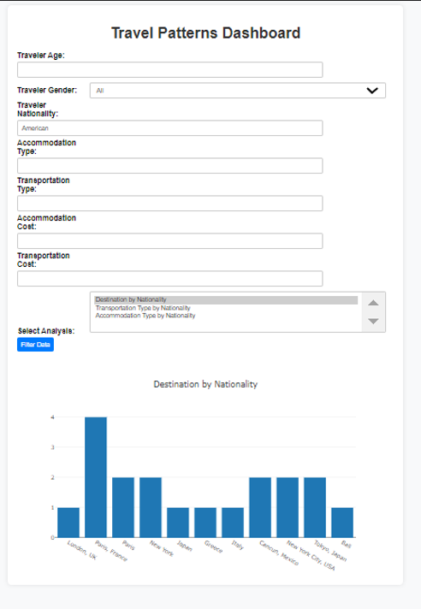
Visualizations
Trip Duration by Traveler Age
Destination by Traveler Nationality
Transportation Type Analysis with Traveler Nationality
Accommodation Type with Traveler Nationality
User Interaction: Filters for age, gender, nationality, accommodation, and transportation types allow users to customize their view.

Slide 6
Analysis and Findings
Key Findings:
Certain destinations are more popular among specific nationalities.
Different age groups prefer different types of transportation and accommodation.
The data shows clear trends in travel duration and preferences based on traveler demographics.
Implications: These findings can help travel agencies tailor their services and marketing strategies to different demographics.

Slide 7
Challenges and Solutions
Challenges:
Inconsistent data formats (e.g., currency formats, date formats).
Handling missing data entries.
Solutions:
Standardized all data formats and filled missing data where possible.

Slide 8
Ethical Considerations
Ethics and Data Usage: The project ensures the responsible use of data by anonymizing personal details and focusing solely on aggregated insights.

Slide 9
Conclusion and Future Work
Summary: The dashboard provides valuable insights into travel patterns and preferences, which can inform better decision-making in the travel industry.
Future Work: Expanding the dataset to include more variables, such as weather conditions or economic factors, could provide deeper insights.

